Slide 1

ANÁLISIS GEOESPACIAL
EDIER V. ARISTIZÁBAL G.
Ing. Geólogo (Universidad Nacional de Colombia)
Esp. en Gestión de Riesgos Geológicos (Universidad de Ginebra – Suiza)
MSc. en Geociencias (Universidad de Shimane – Japón)
PhD. en Ingeniería (Universidad Nacional de Colombia)
Universidad Nacional de Colombia
Facultad de Minas
Departamento de Geociencias

Slide 2
Data is useful to illuminate the path,
but keep following the path to find the full story.

Slide 3
Key Data Properties to Consider in EDA
Structure -- the “shape” of a data file
Granularity -- how fine/coarse is each datum
Scope -- how (in)complete is the data
Temporality -- how is the data situated in time
Faithfulness -- how well does the data capture “reality”

Slide 4
We prefer rectangular data for data analysis (why?)
Regular structures are easy manipulate and analyze
A big part of data cleaning is about transforming data to be more rectangular
Two main variants
Tables (a.k.a. data-frames in R/Python and relations in SQL)
Named columns with different types
Manipulated using data transformation languages
map, filter, group by, join, project,
Matrices
Numeric data of the same type
Manipulated using linear algebra
Fields/Attributes/ Features/Columns
Records/Rows

Slide 5

Tidy Data
Rectangular dataset with a particularly useful format:
Every variable has its own column
Every observation has its own row
Every value has its own cell

Slide 6
Structure: Field Types
Quantitative Data: data with meaningful differences or ratios
Continuous: weight, temperature, volume
Discrete: counts, …
Visualization: histograms and box plots
Ordinal Data: data where relative order matters
Differences between entries may not be the same
Examples:
level of education: [BS, MS, PhD]
Preferences: [Dislike, Like, Must Have]
Visualization: Bar charts (sorted)
Nominal Data: data with no numerical meaning
Examples: names, political affiliation, eye color,
It may be encoded as numbers …
Visualization: Bar charts

Slide 7
Granularity
What does each record represent?
Examples: a purchase, a person, a group of users
Do all records capture granularity at the same level?
Some data will include summaries as records
If the data are coarse how was it aggregated?
Sampling, averaging, …
What kinds of aggregation is possible/desirable?
From individual people to demographic groups?
From individual events to totals across time or regions?
Hierarchies (city/county/state, second/minute/hour/days)
Understanding and manipulating granularity can help reveal patterns.

Slide 8
Manipulating Granularity: Group By
Key
Data
A
A
3
3
B
B
1
1
C
C
4
4
A
A
1
1
B
B
5
5
C
C
9
9
A
A
2
2
B
B
6
6
C
C
5
5

Slide 9
Manipulating Granularity: Group By
Key
Data
A
3
A
3
B
A
1
B
1
1
A
2
C
C
4
4
A
1
B
B
5
5
C
C
9
9
A
2
B
B
6
6
C
C
5
5

Slide 10
Manipulating Granularity: Group By
Key
Data
A
3
A
3
B
1
A
1
A
2
C
4
A
1
B
1
Split into
Groups
B
5
B
5
C
9
B
6
A
2
C
4
B
6
C
9
C
5
C
5

Slide 11
Manipulating Granularity: Group By
Key
Data
A
3
A
3
Aggregate
Function
A
A
6
B
1
A
1
6
A
2
C
4
A
1
B
1
Split into
Groups
Aggregate
Function
B
B
12
B
5
B
5
12
C
9
B
6
A
2
C
4
B
6
C
9
Aggregate
Function
C
C
18
18
C
5
C
5

Slide 12
Manipulating Granularity: Group By
Key
Data
A
3
A
3
A
1
Aggregate
Function
A
6
B
1
A
2
C
4
A
6
A
1
B
1
Split into
Groups
Merge
Results
B
12
B
5
B
5
Aggregate
Function
B
12
C
18
C
9
B
6
A
2
C
4
B
6
C
9
Aggregate
Function
C
18
C
5
C
5

Slide 13
Manipulating Granularity: Pivot
Key R
Key
C
Data
A
A
U
U
3
3
B
B
V
V
1
1
C
C
U
U
4
4
A
A
V
V
1
1
B
B
U
U
5
5
C
C
V
V
9
9
A
A
U
U
2
2
B
B
V
V
6
6
D
D
U
U
5
5

Slide 14
Manipulating Granularity: Pivot
Key R
Key
C
A
U
3
Data
Aggregate
Function
A
U
5
A
U
3
A
U
2
B
V
1
A
V
1
Aggregate
Function
A
V
1
C
U
4
B
U
5
Aggregate
Function
B
U
5
A
V
1
Split into
Groups
B
V
1
Aggregate
Function
B
U
5
B
V
7
B
V
6
C
V
9
C
U
4
Aggregate
Function
C
U
4
A
U
2
C
V
9
Aggregate
Function
C
V
9
B
V
6
D
U
5
D
U
5
Aggregate
Function
D
U
5

Slide 15
Manipulating Granularity: Pivot
Key R
Key
C
A
U
3
Data
Aggregate
Function
A
U
5
A
U
5
A
U
3
A
U
2
B
V
1
Aggregate
Function
A
V
1
A
V
1
A
V
1
C
U
4
B
U
5
Aggregate
Function
B
U
5
B
U
5
A
V
1
Split into
Groups
B
V
1
Aggregate
Function
B
V
7
B
U
5
B
V
7
B
V
6
C
V
9
C
U
4
Aggregate
Function
C
U
4
C
U
4
A
U
2
Aggregate
Function
C
V
9
B
V
6
C
V
9
C
V
9
D
U
5
D
U
5
Aggregate
Function
D
U
5
D
U
5

Slide 16
Manipulating Granularity: Pivot
Key R
Key
C
A
U
3
Data
Aggregate
Function
A
U
5
A
U
3
A
U
2
B
V
1
Aggregate
Function
A
V
1
A
V
1
V
U
V
C
U
4
B
U
5
Aggregate
Function
B
U
5
U
A
1
A
5
A
V
1
Split into
Groups
B
V
1
Aggregate
Function
B
5
7
B
V
7
B
U
5
V
B
V
6
C
V
9
C
4
9
C
U
4
Aggregate
Function
C
U
4
U
D
5
Need to address missing values
A
U
2
Aggregate
Function
C
V
9
B
V
6
C
V
9
V
D
U
5
D
U
5
Aggregate
Function
D
U
5
U

Slide 17
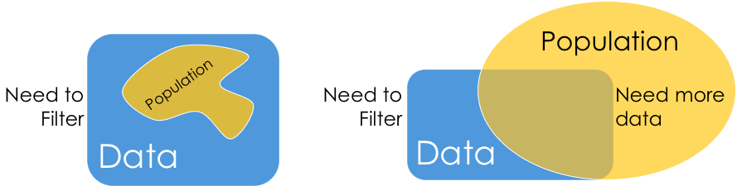
Scope
Does my data cover my area of interest?
Example: I am interested in studying crime in California but I only have Berkeley crime data.
Is my data too expansive?
Example: I am interested in student grades for DS100 but have student grades for all statistics classes.
Solution: Filtering → Implications on sample?
If the data is a sample I may have poor coverage after filtering …
Does my data cover the right time frame?
More on this in temporality …

Slide 18
Temporality
What is the meaning of a the time and date fields?
When the “event” happened?
When the data was collected or was entered into the system?
Time depends on where? (Time zones & daylight savings)
Multiple string representation (depends on region): 08/08/08?
Are there strange null values?
January 1st 1970, January 1st 1900
Date the data was copied into a database (look for many matching timestamps)
Is there periodicity? Diurnal patterns

Slide 19
Faithfulness: Do I trust this data?
Does my data contain unrealistic or “incorrect” values?
Examples?
Dates in the future for events in the past
Locations that don’t exist
Negative counts
Misspellings of names
Large outliers
Does my data violate obvious dependencies?
E.g., age and birthday don’t match
Was the data entered by hand?
Spelling errors, fields shifted …
Did the form require fields or provide default values?
Are there obvious signs of curb stoning (data falsification):
Repeated names, fake looking email addresses, repeated use of uncommon names or fields.

Slide 20
Signs that your data may not be faithful
Missing Values/Default values: (0, -1, 999, 12345, NaN, Null, 1970, 1900, … others?)
Soln 1: Drop records with missing values → implications on your sample!
Soln 2: Impute missing values → Bias your conclusions
Time Zone Inconsistencies
Soln 1: convert to a common timezone (e.g., UTC)
Soln 2: convert to the timezone of the location – useful in modeling behavior.
Duplicated Records or Fields
Soln: identify and eliminate (use primary key) → implications on sample?
Spelling Errors
Soln: Apply corrections or drop records not in a dictionary → implications on sample?
Units not specified or consistent
Solns: Infer units, check values are in reasonable ranges for data
Truncated data (early excel limits: 65536 Rows, 255 Columns)
Soln: be aware of consequences in analysis → how did truncation affect sample?
Others…
Notes:
Negative numbers, large outliers, failed parsing …

Slide 21
Model - a set of patterns learned from data.
Algorithm - a specific ML process used to train a model.
Training data - the dataset from which the algorithm learns the model.
Test data - a new dataset for reliably evaluating model performance.
Features - Variables (columns) in the dataset used to train the model.
Target variable - A specific variable you're trying to predict.
Observations - Data points (rows) in the dataset.

Slide 22
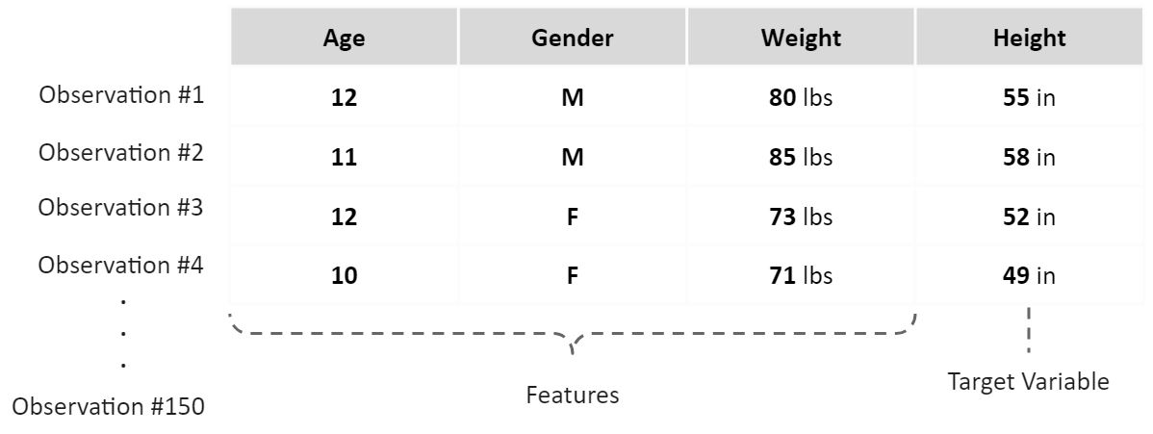

Slide 23

CONSTRUCCIÓN DEL MODELO → Datos → Variables

Slide 24
CONSTRUCCIÓN DEL MODELO NUMÉRICO
Variables
Resultado
Entrenar
Machine Learning

Slide 25
VARIABLES (FEATURES)
Propiedad, atributo, característica, aspecto o dimensión de un objeto, hecho o fenómeno que puede variar y cuya variación es medible.
Ser observable Su información debe ser concreta y evidente en la realidad.
Ser cambiante Puede adquirir diferentes categorías y valores
Ser medible puede ser cuantificable
Tener referencia conceptual Deben emanar de un previo conocimiento teórico de la realidad

Slide 26
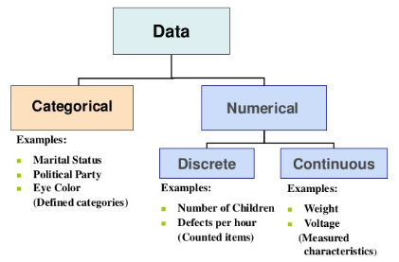
TIPO DE VARIABLES
Variables categóricas: Expresan una cualidad, característica o atributo que solo se pueden clasificar o categorizar mediante el conteo. Se establecen en rango o categorías.
Variable categórica
Las variables categóricas contienen un número finito de categorías o grupos distintos.

Slide 27
Note that data categorical data can also be numbers and quantitative data may be stored as strings.
Kinds of
Data
Categorical Data
Quantitative Data
Numbers with meaning ratios or intervals.
Ordinal
Nominal
Examples:
Price
Quantity
Temperature
Date
…
Categories with orders but no consistent meaning if magnitudes or intervals
Categories with no
specific ordering.
Examples:
Preferences
Level of education
…
Examples:
Political Affiliation
CalD number
…

Slide 28
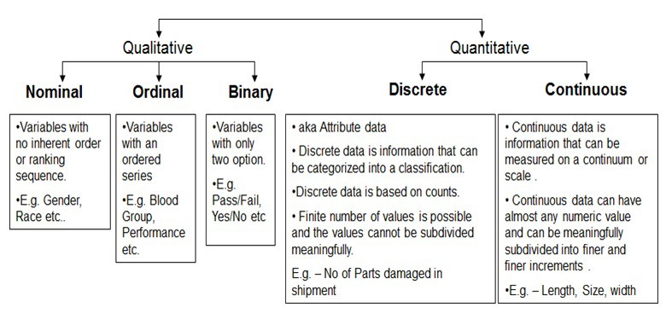
TIPO DE VARIABLES

Slide 29
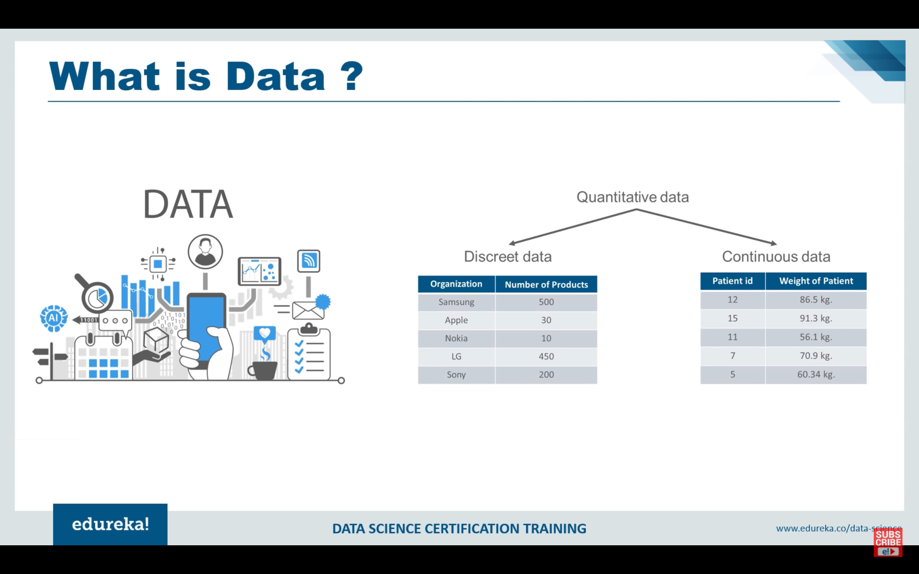
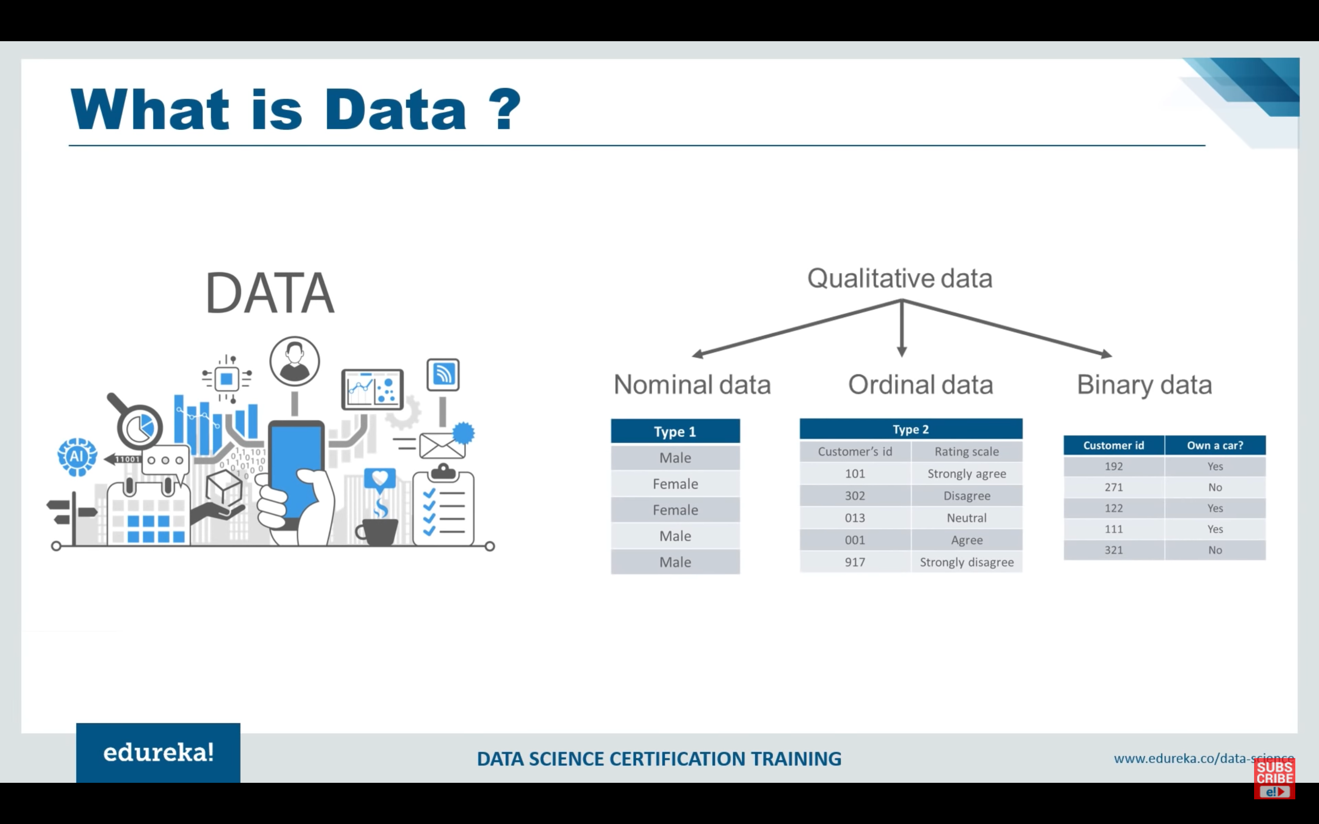
VARIABLES CUALITATIVAS (CATEGÓRICAS)
Variables Ordinales:
Permiten clasificaciones de mayor a menor.
Ej. Pendiente
Variables nominales:
Solo indican diferencia de categoría.
Ej. Uso del suelo
Variables Dicotómicas:
Pueden tomar solo dos variables.
Ej. Inv. de deslizamientos

Slide 30
VARIABLES CUANTITATIVAS (NUMÉRICAS)
Variables discretas
son aquellas cuyas observaciones solo pueden ser contadas y se agrupan ‘inherentemente’ o ‘naturalmente’ en categorías, porque sólo pueden tomar los valores que únicamente pertenecen al conjunto
Variables continuas:
variables numéricas que no pueden ser contadas y tienen un número infinito de valores entre un intervalo determinado. Nunca puede ser medido con exactitud y depende de la precisión de los equipos de medida.

Slide 31
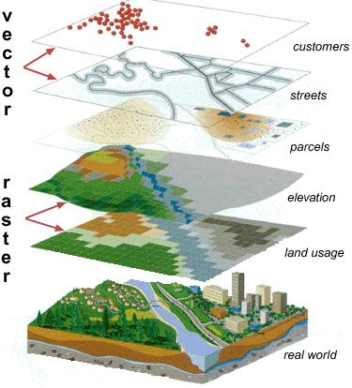
DATOS GEOSPACIALES
Geospatial data is data about objects, events, or phenomena that have a location on the surface of the earth, including location information (usually coordinates on the earth), attribute information (the characteristics of the object, event, or phenomena concerned), and often also temporal information (the time or life span at which the location and attributes exist).

Slide 32
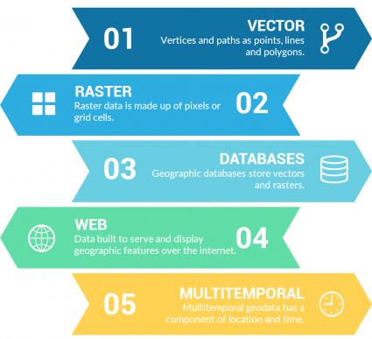
DATOS GEOSPACIALES

Slide 33

CONTINUOUS RASTERS
Continuous rasters (non-discrete) are grid cells with gradual changing data such as elevation, temperature or an aerial photograph. A continuous raster surface can be derived from a fixed registration point. For example, digital elevation models use sea level as a registration point. Each cell represents a value above or below sea level.

Slide 34

DISCRETE RASTERS
Discrete rasters have distinct themes or categories. For example, one grid cell represents a land cover class or a soil type.
In a discrete raster land cover/use map, you can distinguish each thematic class. Each class can be discretely defined where it begins and ends. In other words, each land cover cell is definable and it fills the entire area of the cell.
Discrete data usually consists of integers to represent classes.

Slide 35
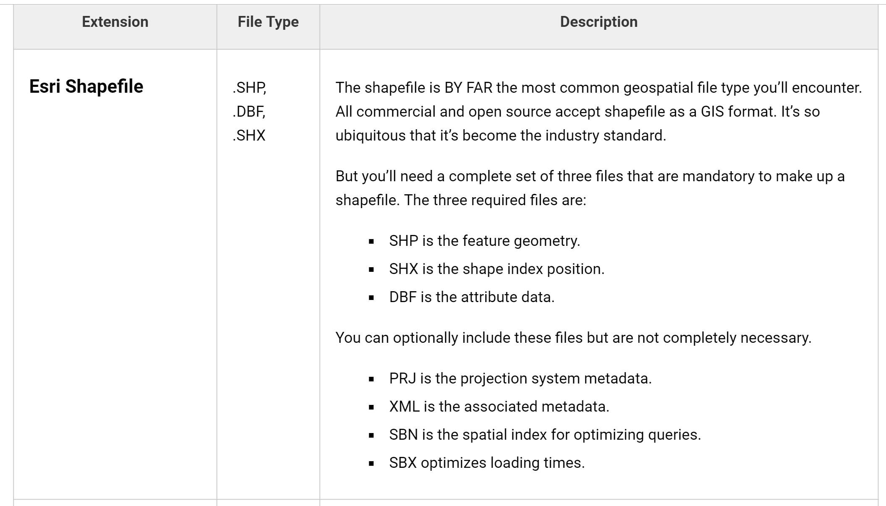
Vector GIS File Formats:
Vector graphics are comprised of vertices and paths.
The three basic symbol types for vector data are points, lines and polygons (areas). These GIS file formats house vector data.

Slide 36
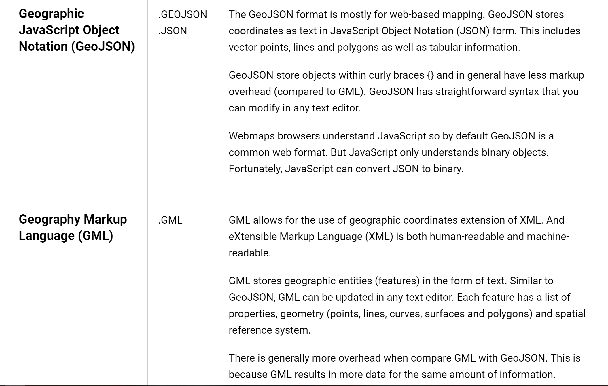
Vector GIS File Formats:

Slide 37
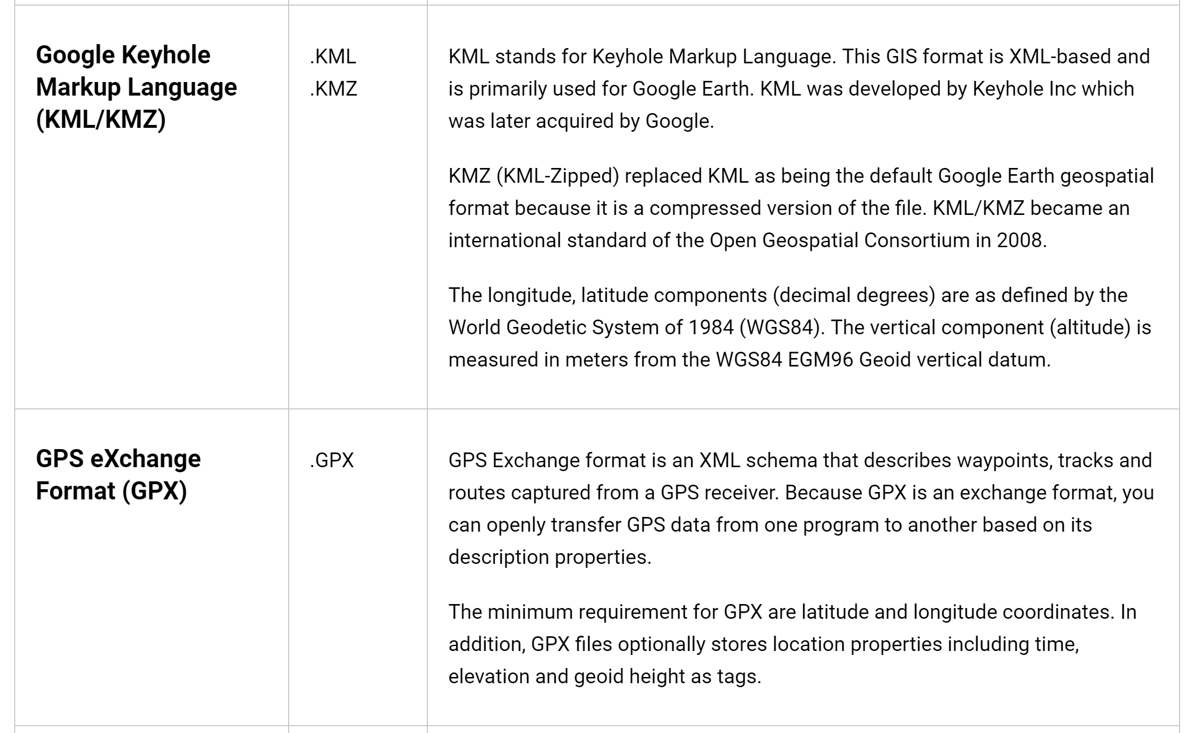
Vector GIS File Formats:

Slide 38
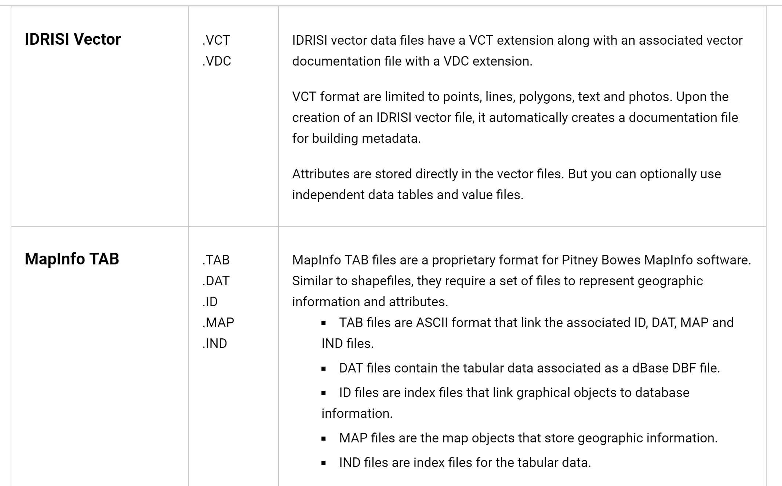
Vector GIS File Formats:

Slide 39
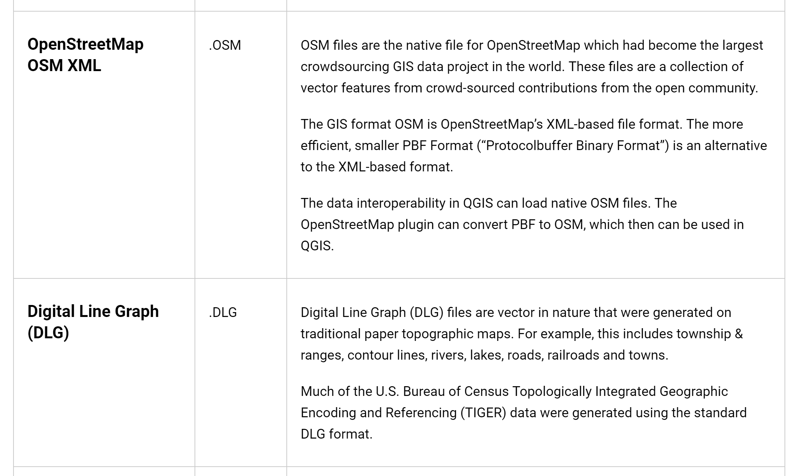
Vector GIS File Formats:

Slide 40
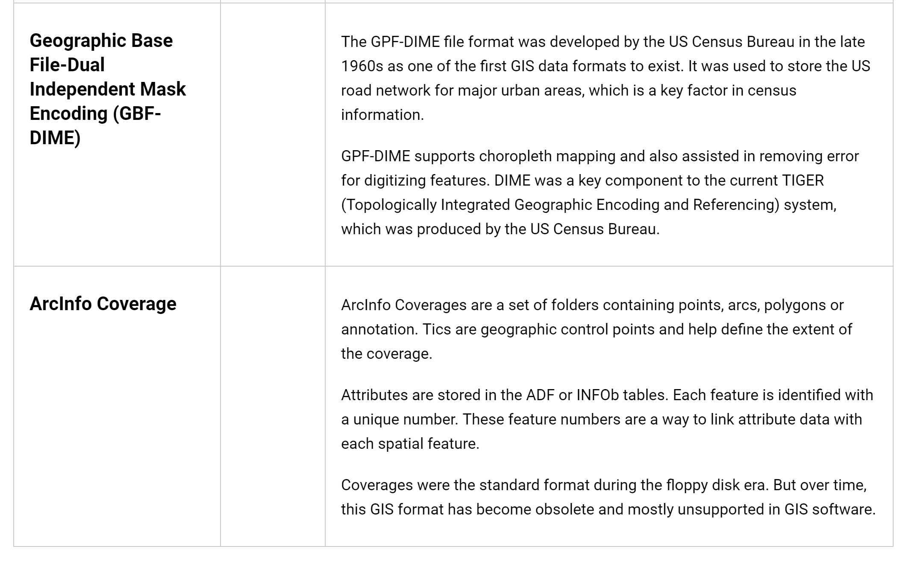
Vector GIS File Formats:

Slide 41
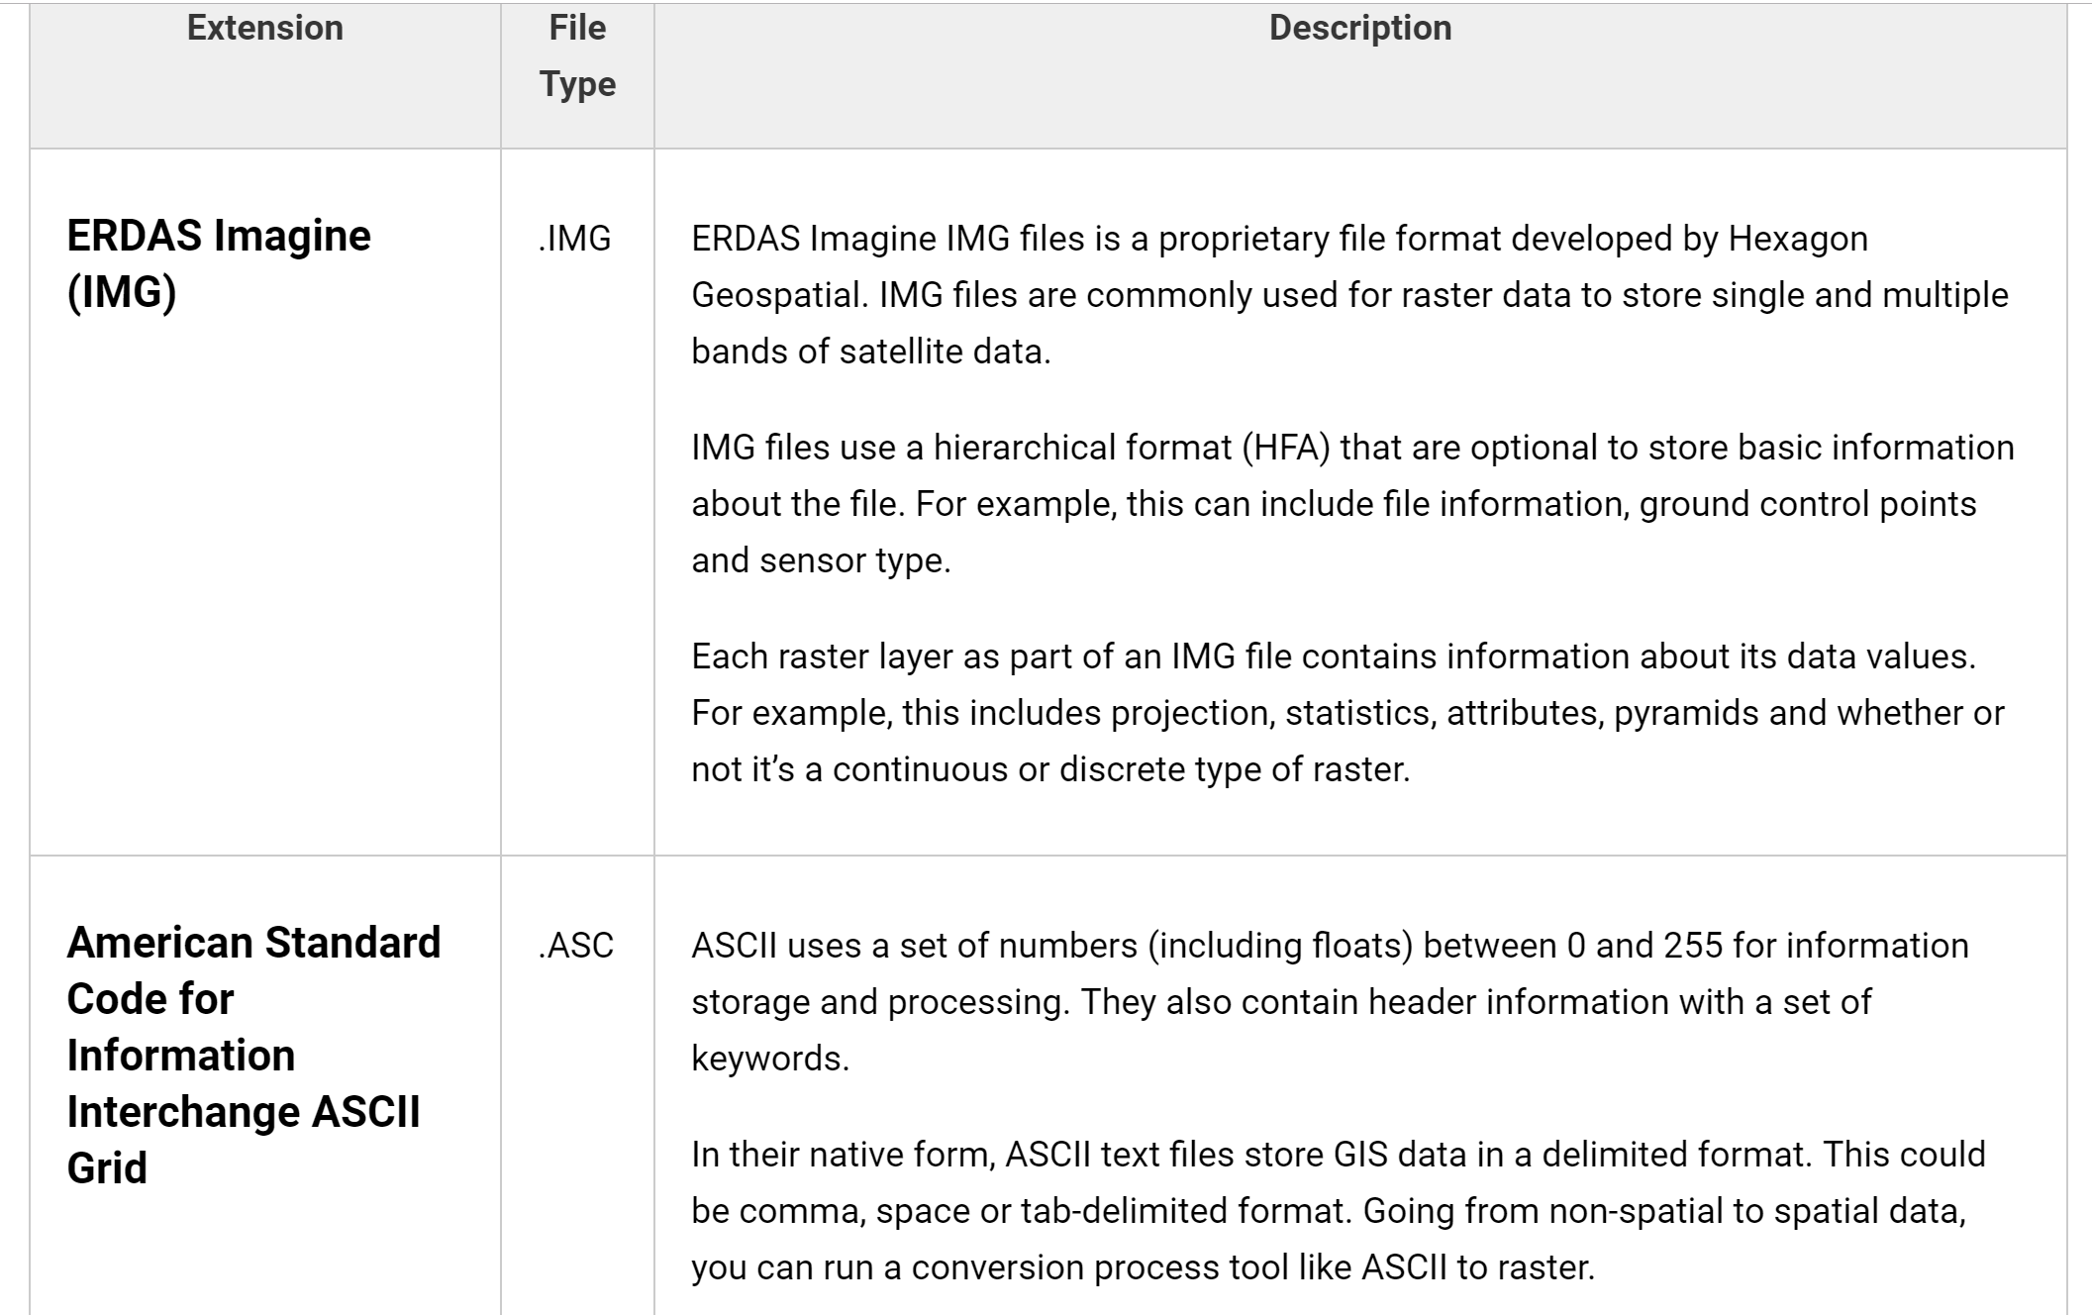
Raster GIS File Formats
Raster data is made up of pixels (also referred to as grid cells). They are usually regularly-spaced and square but they don’t have to be.
Rasters have pixel that are associated with a value (continuous) or class (discrete).

Slide 42
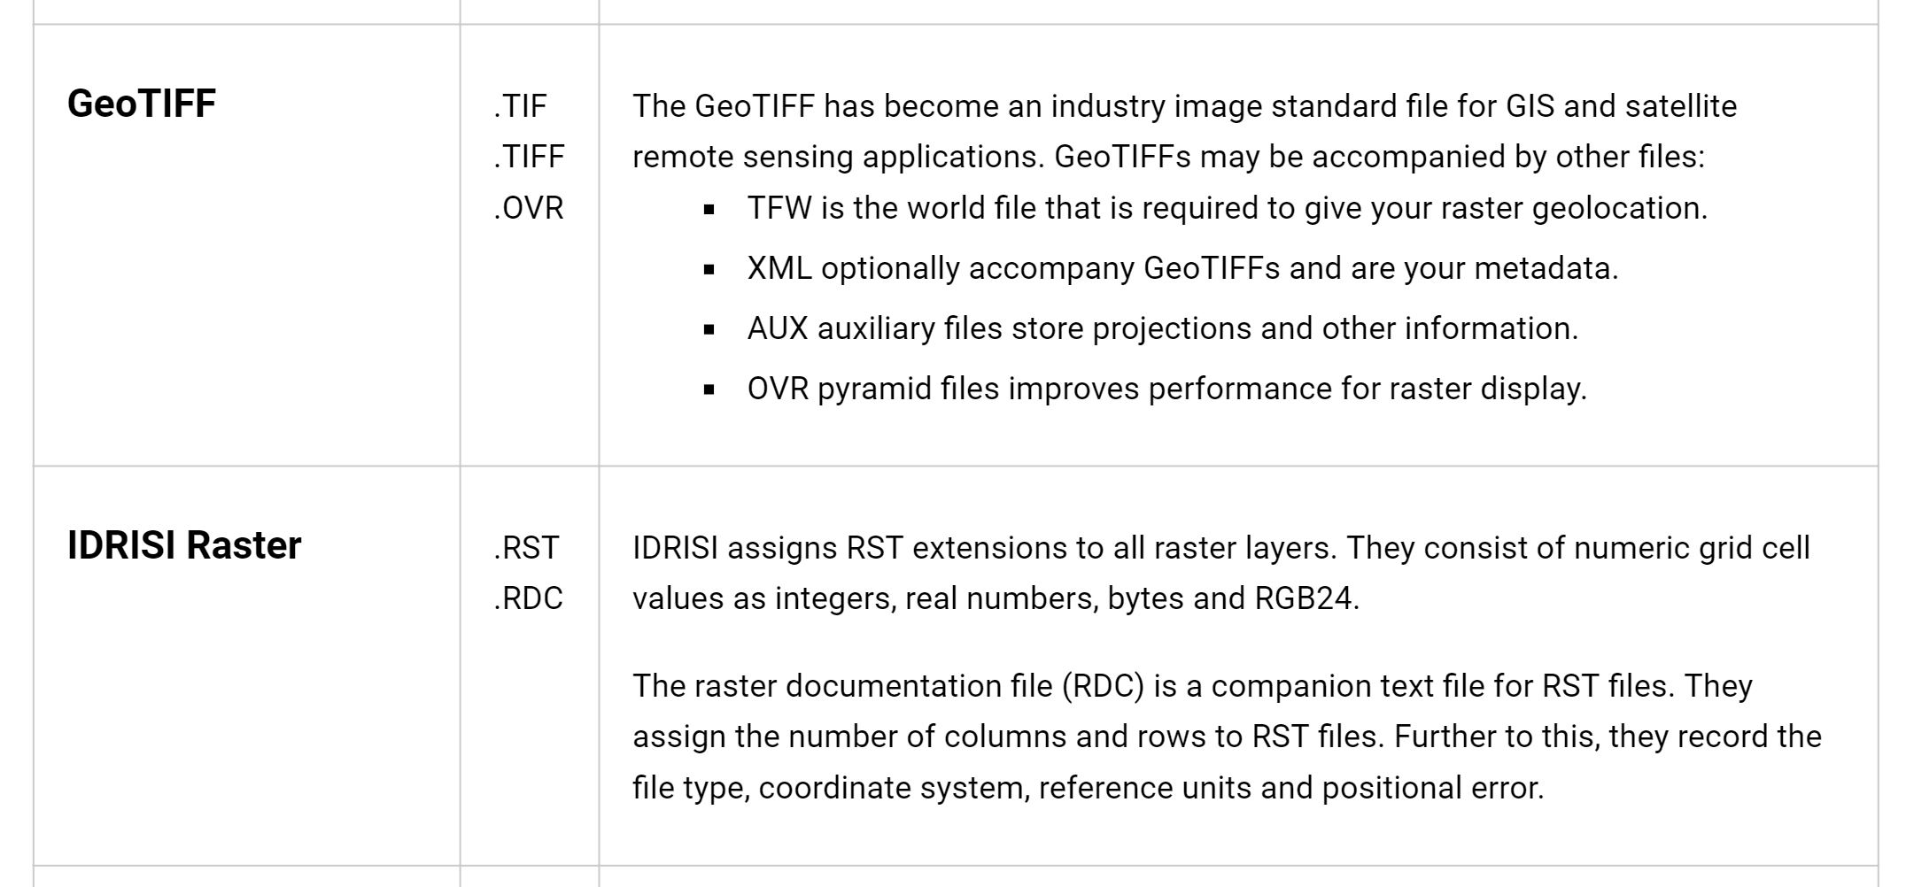
Raster GIS File Formats

Slide 43
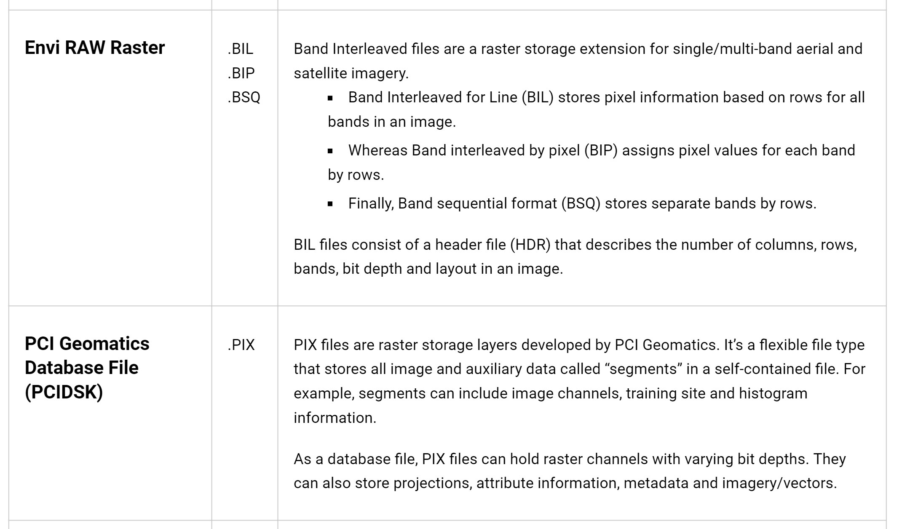
Raster GIS File Formats

Slide 44
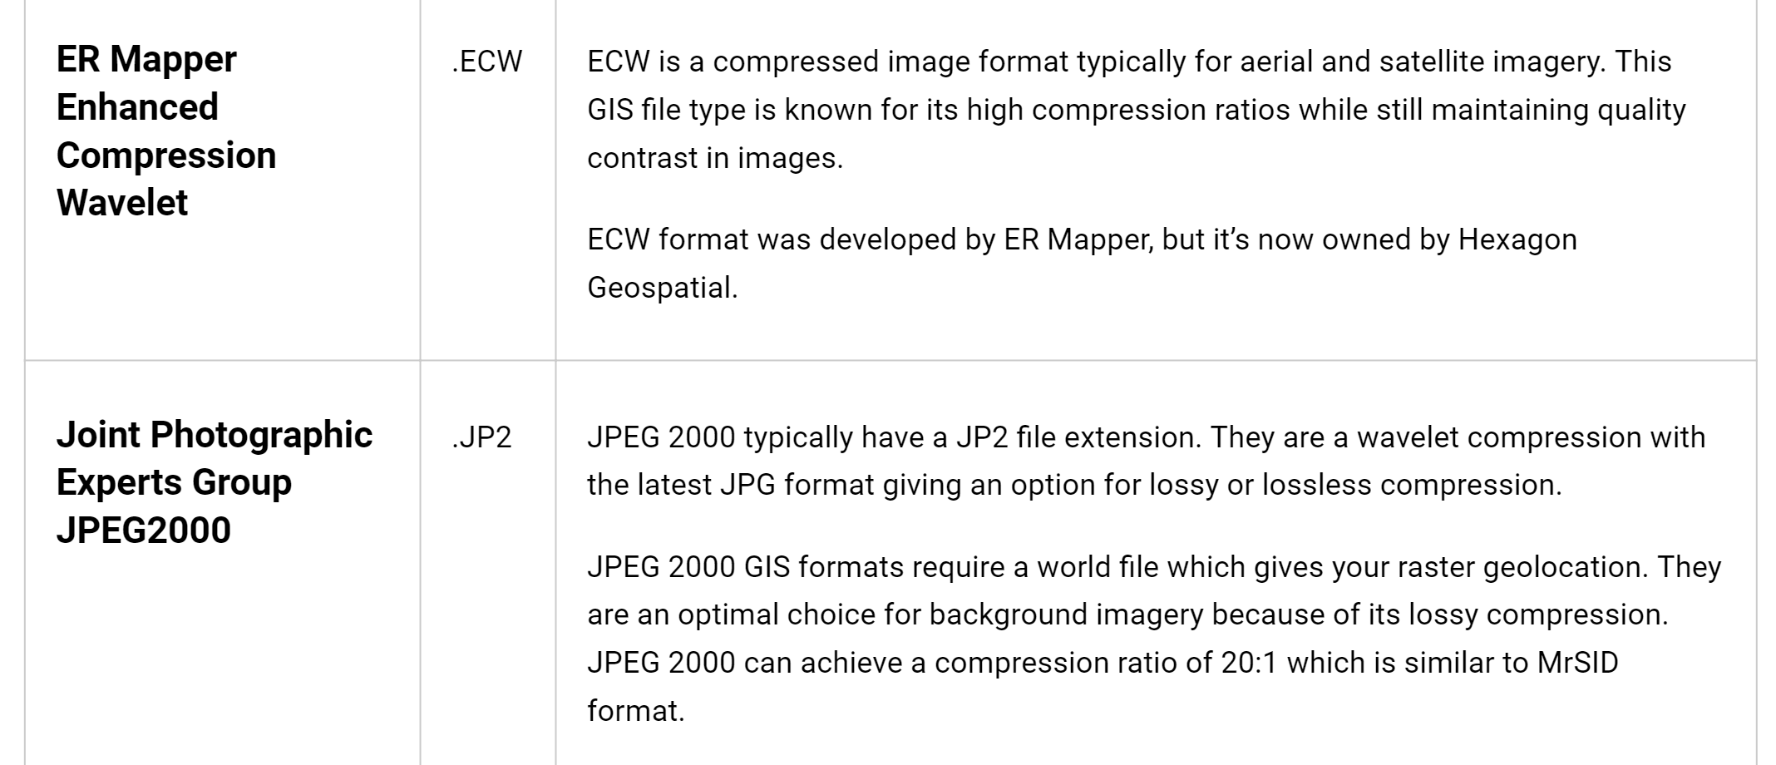
Compressed Raster File Formats
Lossy GIS compression reduces file size by permanently eliminating certain information, especially redundant information (even though the user may not notice it).
These lossy compression algorithms often result in greater reductions of file size. Here are examples of highly compressed GIS formats.

Slide 45
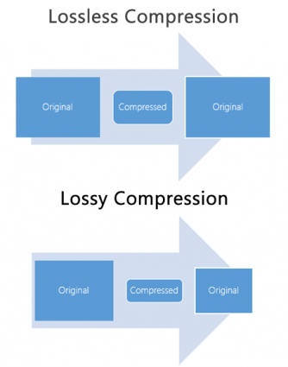
JPEG Compression Example
JPEG stands for Joint Photographic Experts Group, which is the group that created the standard. It has an extension of .JPG and .JPEG and is the most common image format used by digital cameras and on the World Wide Web.
It’s a lossy compression type for digital images. Lossy image compression reduces file size and eliminates redundant information. The user decides how much loss to introduce with a trade-off in storage size and quality.
For example, the compression quality is a range from 1 to 100. A lower value compresses the raster image, but also reduces the quality.
JPEG 2000 (JP2) is the newest version of JPEG. It slightly improves image compression performance over JPEG using two different wavelet transforms. Users can choose low to high levels of compression.

Slide 46
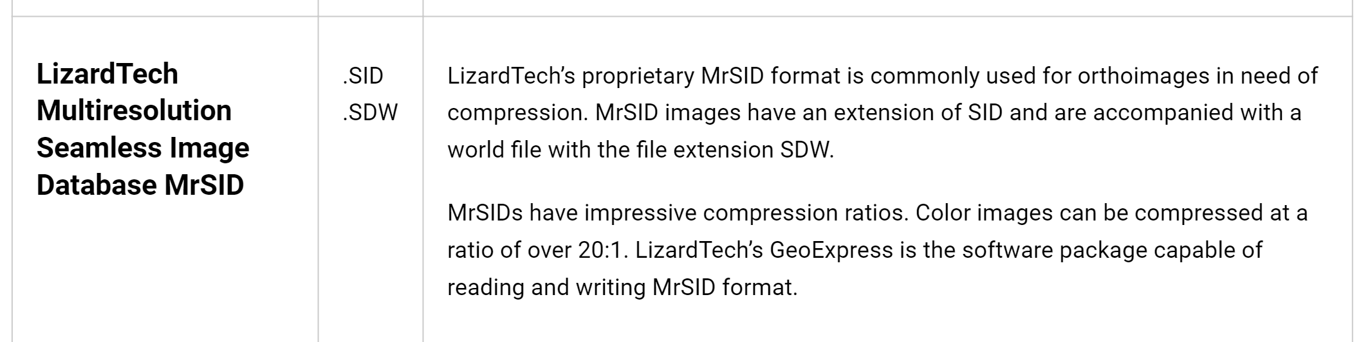

Slide 47
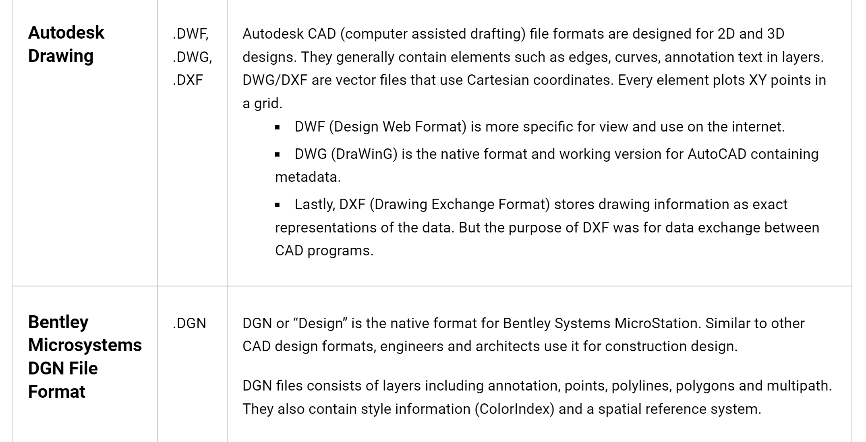
CAD File Formats
CAD (computer assisted drafting) often goes hand-in-hand with Geographic Information System (GIS). GIS imports design models that were likely built in Autodesk or Bentley Systems MicroStation.

Slide 48
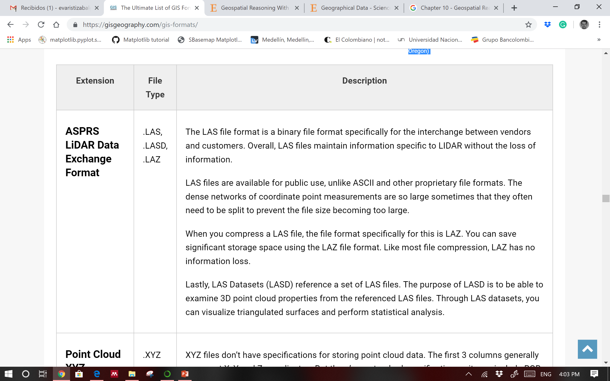
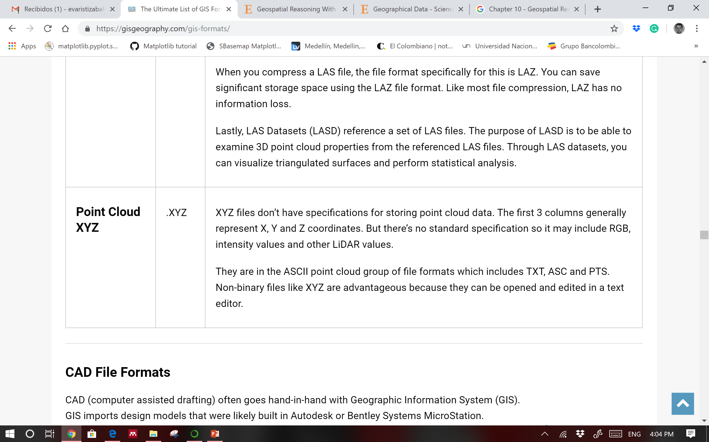
LiDAR File Formats

Slide 49
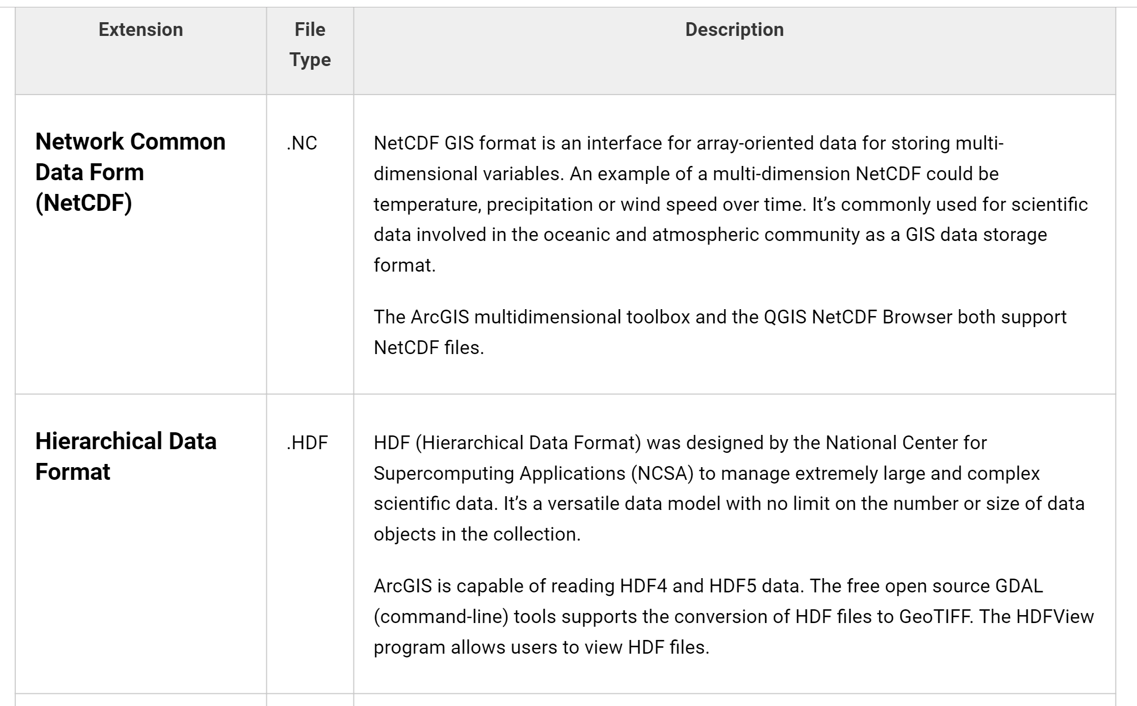
Multitemporal File Formats
Temporal data has a time component attached to it. A lot of weather data uses temporal GIS data formats because how important time is related to weather.

Slide 50
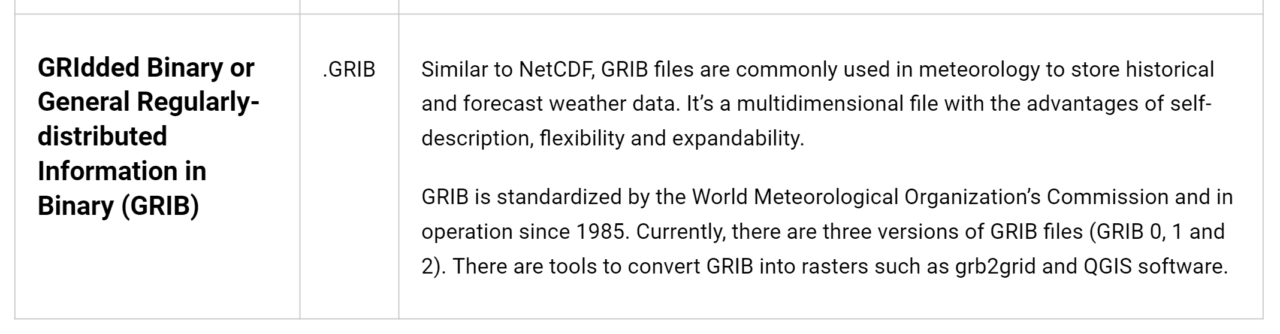

Slide 51
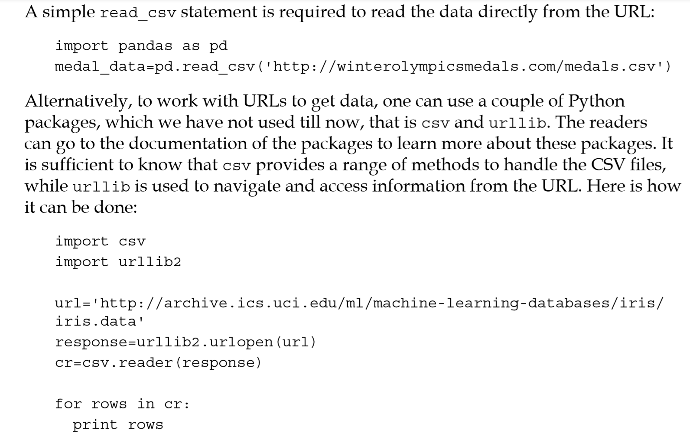
IMPORTAR DATOS

Slide 52
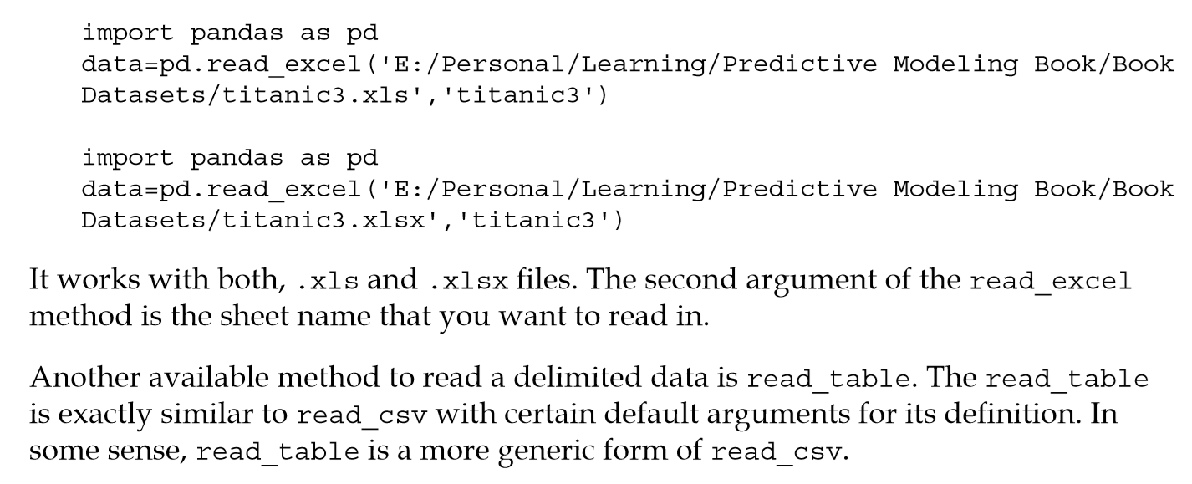
IMPORTAR DATOS

Slide 53
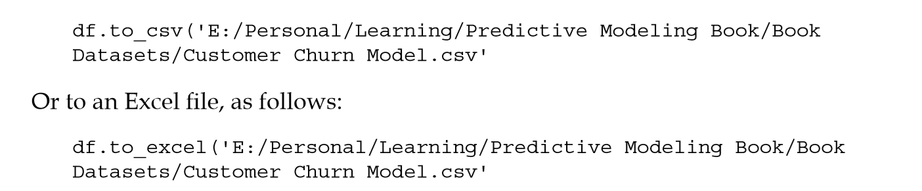
EXPORTAR DATOS

Slide 54
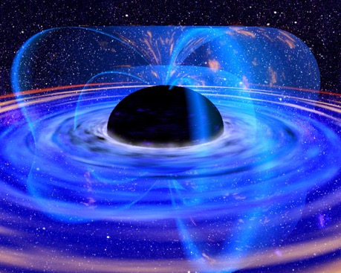
What is a model?
A model is an an idealized representation of a system
Atoms don’t actually work like this…
Proteins are far more complex
We haven’t really seen one of these.

Slide 55
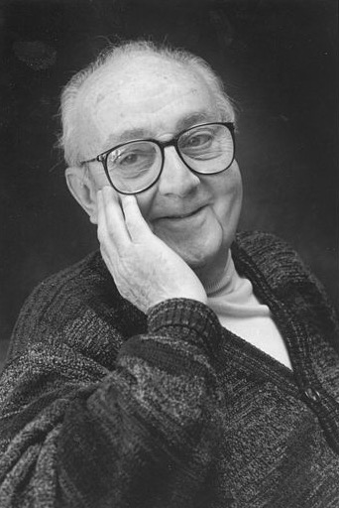
“Essentially, all models are wrong, but some are useful.”
George Box
Statistician
1919-2013
Notes:
1919-2013

Slide 56
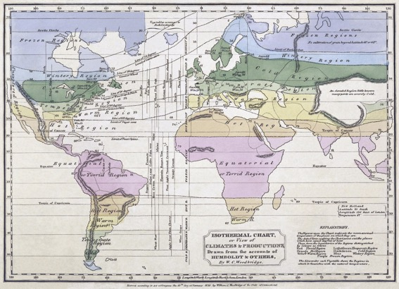


Why do we build models?
Models enable us to make accurate predictions

Slide 57

Why do we build models?
Models enable us to make accurate predictions
Provide insight into complex phenomena

Slide 58
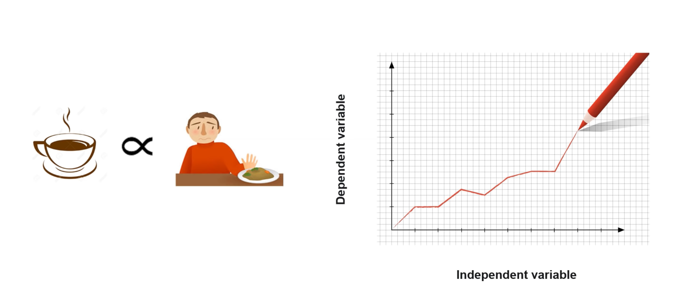
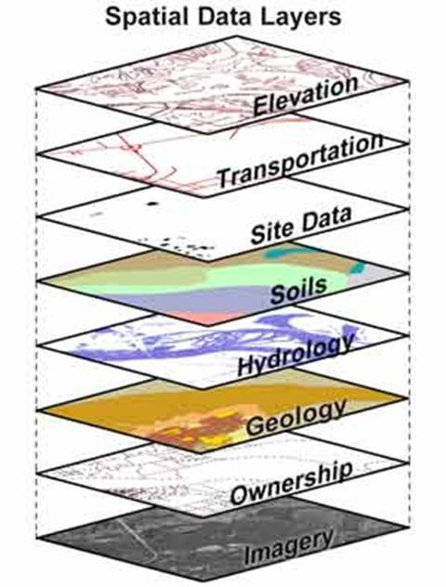
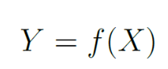
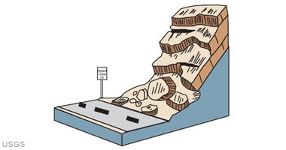
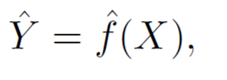
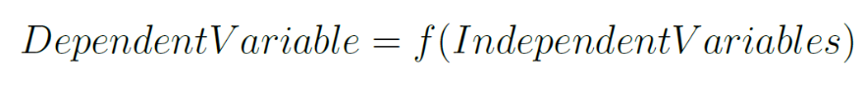
MODELO BASADO EN DATOS
X = Variables independientes – preparatorias - explicativas – cuasiestáticas - condicionantes – predictoras – intrínsecas (Features).
Característica o propiedad que se supone ser la causa del fenómeno estudiado. Ej. Geología, pendiente, aspecto, etc, etc.
(Y)
(X)
Y = Variable dependiente (Labels o números).
Es el factor que es observado y medido para determinar el efecto de las variables independientes.

Slide 59
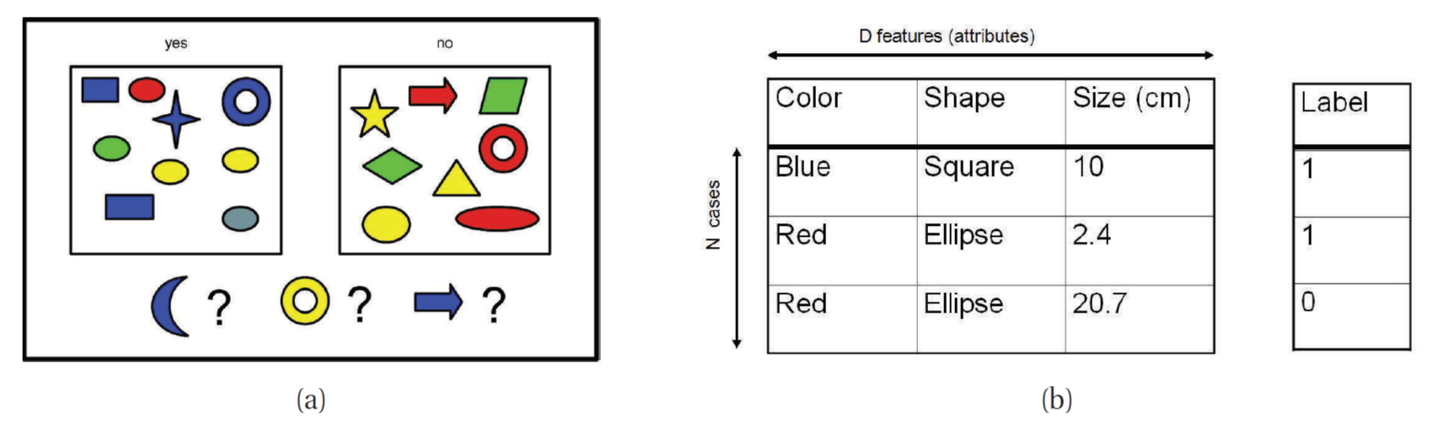
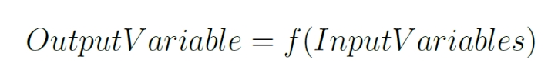
MODELO BASADO EN DATOS
Realidad
Datos
To estimate unknown dependency between the input and output variables, from a set of past observations
Realidad
Modelo basado en datos
Causas
Features
Efecto
Label
Mecanismo
Función objetivo

Slide 60
PARA QUÉ ESTIMAR LA FUNCIÓN f(x)
Modelos explicativos
In this situation we wish to estimate f, but our goal is not necessarily to make predictions for Y. We instead want to understand the relationship between X and Y , or more specifically, to understand how Y changes as a function of X1, . . .,Xp.
f cannot be treated as a black box, because we need to know its exact form. In this setting, one may be interested in answering the following questions:
Which predictors are associated with the response? It is often the case that only a small fraction of the available predictors are substantially associated with Y . Identifying the few important predictors among a large set of possible variables can be extremely useful, depending on the application.
What is the relationship between the response and each predictor? Some predictors may have a positive relationship with Y, in the sense that increasing the predictor is associated with increasing values of Y . Other predictors may have the opposite relationship.
Can the relationship between Y and each predictor be adequately summarized using a linear equation, or is the relationship more complicated?

Slide 61
PARA QUÉ ESTIMAR LA FUNCIÓN f(x)
Modelos predictivos
In many situations, a set of inputs X are readily available, but the output Y cannot be easily obtained. In this setting, since the error term averages to zero, we can predict Y using
where ḟ represents our estimate for f real, and Ŷ represents the resulting prediction for Y real.
In this setting, ḟ is often treated as a black box, in the sense that one is not typically concerned with the exact form of f, provided that it yields accurate predictions for Y.

Slide 62
DEPENDENCY (ASSOCIATION) vs CAUSALITY
Statistical dependency does not imply causality
Sometimes the existence of statistical dependencies between system inputs and outputs is (erroneously) used to demonstrate cause-and-effect relationship between variables of interest.
Causality cannot be inferred from data analysis alone; instead, it must be assumed or demonstrated by an argument outside the statistical analysis.
It does not make sense to claim causal relationship between person’s height and weight, even though statistical dependency (correlation) between height and weight can be easily demonstrated from data

Slide 63
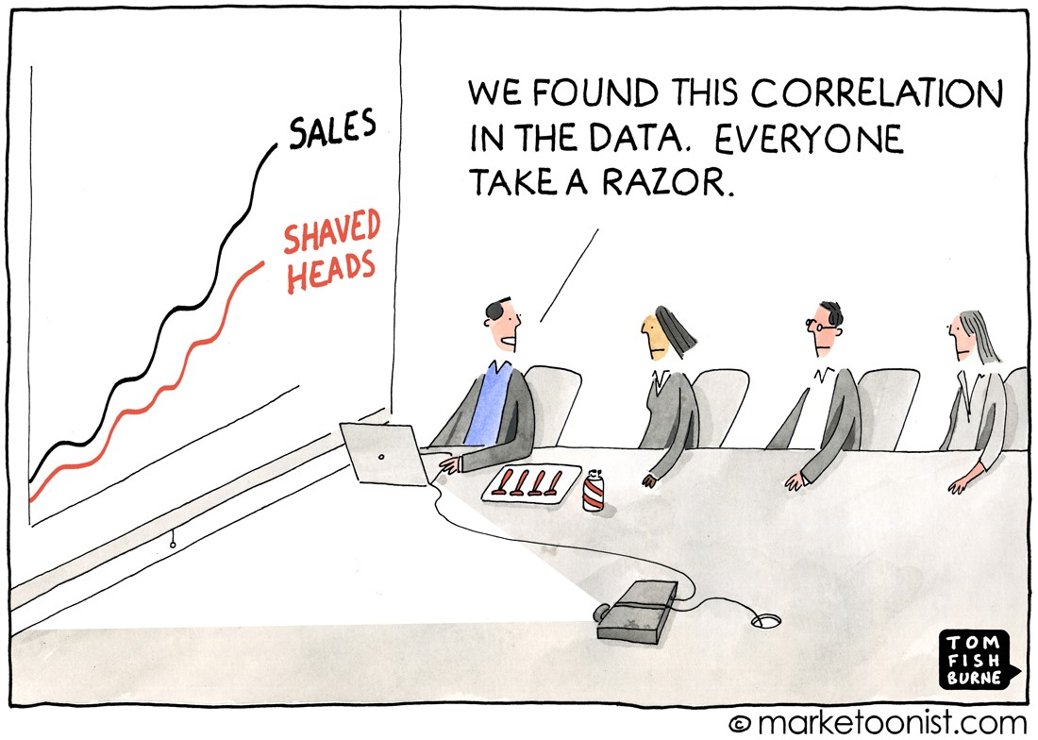

Slide 64
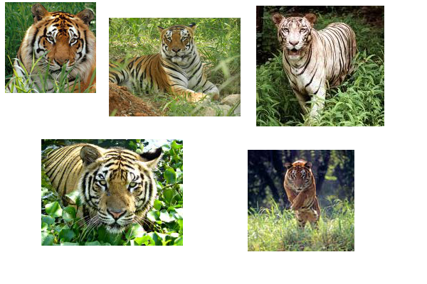
DATOS DE ENTRENAMIENTO
(Vincenzo Lavorini, 2019) www.towardsdatascience.com

Slide 65

DATOS DE PRODUCCIÓN
correlations caused by a confounding (hidden feature (H) ) factor → tiger is the animal you know surrounded by “forest”
It’s effect can in fact confuse the model, letting it believe that there is a causal correlation between the animal and the forest which actually do not exist. In other words, our model do believes the tiger is the hidden feature H, and not simply the tigers as the animals we know.
(Vincenzo Lavorini, 2019) www.towardsdatascience.com

Slide 66
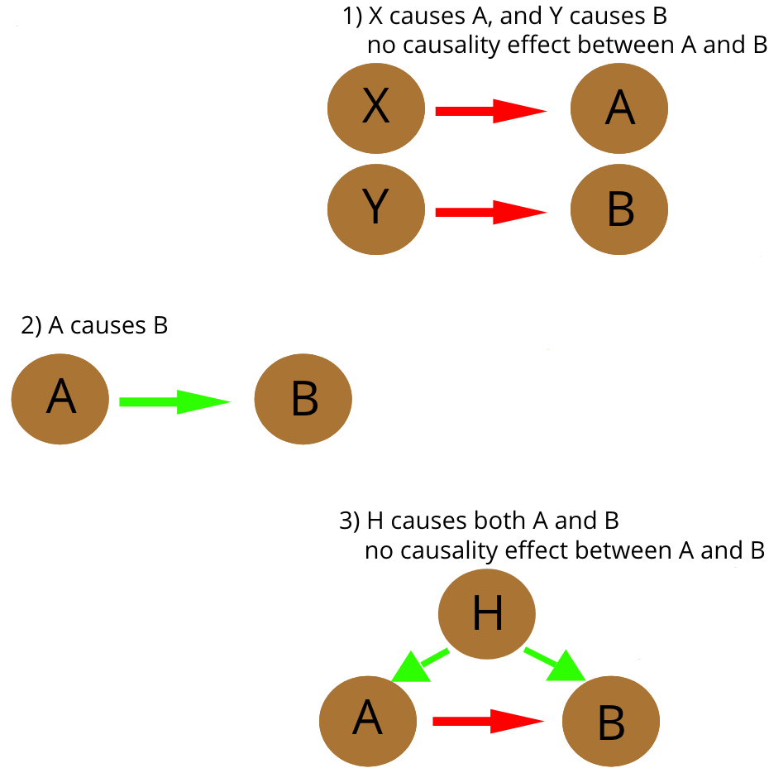
data leakage
It is the only one we can safely accept. An example can be the stripes in the tigers: since there are no tigers without stripes, it’s safe for the model to classify a tiger if and only if there are stripes on the animal.

Slide 67
DATA LEAKAGE
the introduction of information about the target of a data mining problem, which should not be legitimately available to mine from.

Slide 68
CAUSALIDAD vs ASOCIACIÓN
En los modelos explicativos f representa una función causal que subyace y se asume que X causa Y.
En modelos predictivos la función f captura la asociación entre X y Y.

Slide 69
MODELOS EXPLICATIVOS vs MODELOS PREDICTORIOS
Los modelos explicativos se refieren a la aplicación a datos de modelos estadísticos para verificar hipótesis causales sobre construcciones teóricas. En la práctica los modelos estadísticos basados en asociación aplicados a datos observacionales son comúnmente utilizados para ese propósito.
Los científicos están entrenados para reconocer que correlación es no causalidad, no es recomendable sacar conclusiones solo basado en la correlación entre X y Y (es posible que solo sea una coincidencia). Por lo tanto, se debe entender el mecanismo que subyace y que conecta X y Y. Cuando se tiene un modelo, se puede concretar los datos con confidencia.
Los datos sin un modelo son simple ruido.

Slide 70
MODELOS EXPLICATIVOS vs MODELOS PREDICTORIOS
Los modelos predictivos son los procesos de aplicar a datos modelos estadísticos o algoritmos de data mining cuyo propósito es predecir nuevos datos o futuras observaciones. Los modelos predictivos son cualquier método que produce predicciones, sin importar el método utilizado: Bayesiano o frecuentista, paramétrico o no-paramétrico, data mining o modelo estadístico, etc.
En la era de los datos, el acercamiento de la ciencia (hipótesis, modelo, verificación) se está volviendo obsoleto. En la era de los datos sería posible decir correlación es suficiente . Se puede parar de obtener modelos. Se puede analizar los datos sin hipótesis y solo a partir de lo que muestran los datos. Se puede cargar los números y datos en el cluster de computadores mas grande del mundo y dejar que los algoritmos estadísticos encuentren patrones donde los científicos no pueden.
Considerando la física: los modelos de Newton son crudas aproximaciones de la realidad, no se ajustan a la escala atómica, pero son útiles. Hace muchas décadas, la mecánica cuántica ofrece una mejor aproximación, sin embargo es un modelo mas, y seguramente también simplifica una realidad que subyace mucho mas compleja.

Slide 71
MODELOS EXPLICATIVOS vs MODELOS PREDICTORIOS
De acuerdo con Simon (2001) distingue entre ciencia básica y ciencia aplicada de forma similar a modelos explicativos y modelos predictivos.
La ciencia básica busca conocer (describir el mundo) y entenderlo (proveer explicaciones de este fenómeno).
Las ciencias aplicadas por el contrario buscan leyes que conecten un conjunto de variables que permita obtener inferencias o predicciones a partir de valores conocidos de algunas de las variables a valores desconocidos de otras variables.

Slide 72
TEORÍA vs DATOS
En los modelos explicativos, la función f es cuidadosamente construida basada en F, en una forma que soporte interpretando la relación estimada entre X y Y, y testeando la hipótesis causal.
En modelos predictivos, la función f es generalmente construida a partir de los datos. La interpretación directa en términos de la relación entre X y Y no es requerida, aunque en algunos casos la transparencia de la función f es deseada.

Slide 73
RETROSPECTIVA vs PROSPECTIVA
En los modelos predictivos miran hacia adelante, por lo que la función f es construida para predecir nuevas observaciones.
En modelos explicativos mira hacia atrás, por lo que la función f es utilizada para testear las hipótesis planteadas.

Slide 74
DATOS
DATOS REDUCIDOS: En los modelos basados en una cantidad de datos finitos, sí existe una diferencia significativa entre modelos explicativos y modelos predictivos, ya que un modelo optimo para propósitos de predicción puede ser muy diferente a un modelo obtenido para estimar la función o el modelo verdadero.
BIG DATA: Puede no existir una diferencia significativa entre modelos explicativos y predictivos para inferir la verdadera estructura de la función f o hacer predicciones cuando se cuenta con datos infinitos o si no existe ruido en los datos.

Slide 75
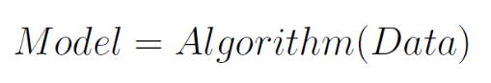
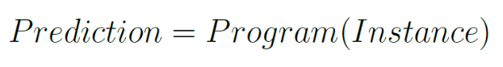
MODELO BASADO EN DATOS
REALIDAD
MODELO
EXPLICATIVO
MACHINE LEARNING
A learning method is an algorithm (usually implemented in software) that estimates an unknown mapping (dependency) between a system’s inputs and outputs from the available data, namely from known (input, output) samples. Once such a dependency has been accurately estimated, it can be used for prediction of future system outputs from the known input values
MODELO
PREDICTIVO

Slide 76

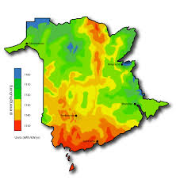
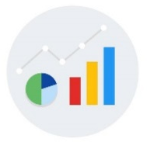
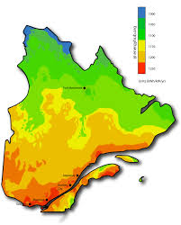

DATA SCIENCE
Entrenamiento
Predicción
Nuevos datos →
Datos →
→ Programa →
→ Resultados
Resultados →
Modelo explicativo
Modelo predictivo

Slide 77
CONSTRUCCIÓN DEL MODELO → Datos → Variables

Slide 78
CONSTRUCCIÓN DEL MODELO NUMÉRICO
Función objetivo
(Cuáles son las características de la flor que permiten diferenciar su especie?)

